Slide 1
Design patterns: The singleton Pattern
Bui Vu Khoa – 1042108
Pham Tuan Kiet - 1042103

Slide 2
Table of contents
Definition
What is multithreading
Solving Singleton multithreading issues
How to improve Singleton in multithreading
​Code showcase

Slide 3
Definition
Restricts the instantiation of a class to one single instance
Unique, easily accessible class instance
Private constructor, static method

Slide 4
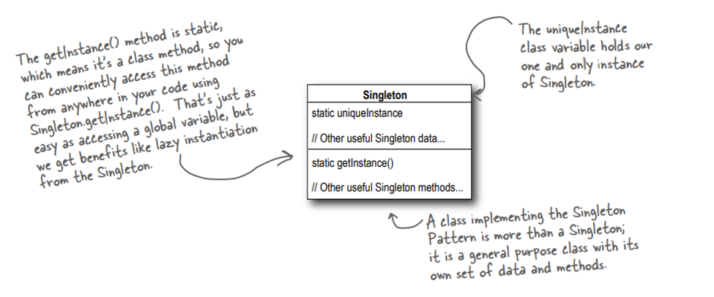
How it works

Slide 5
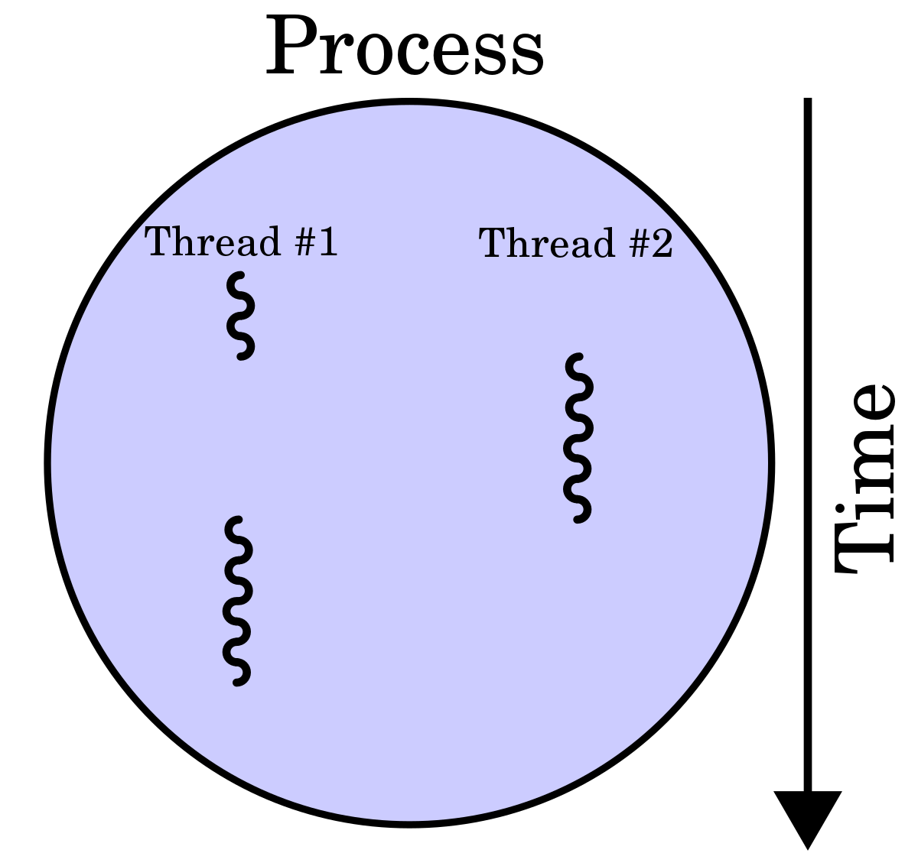
What is multithreading
Concurrent execution of two or more parts of a program for maximum utilization of the CPU

Slide 6

Solving Singleton multithreading issues
Using synchronization method
Make getInstance() a synchronized method

Slide 7



How to improve Singleton in multithreading
Do nothing
Eager
initialization
double-checked locking

Slide 8
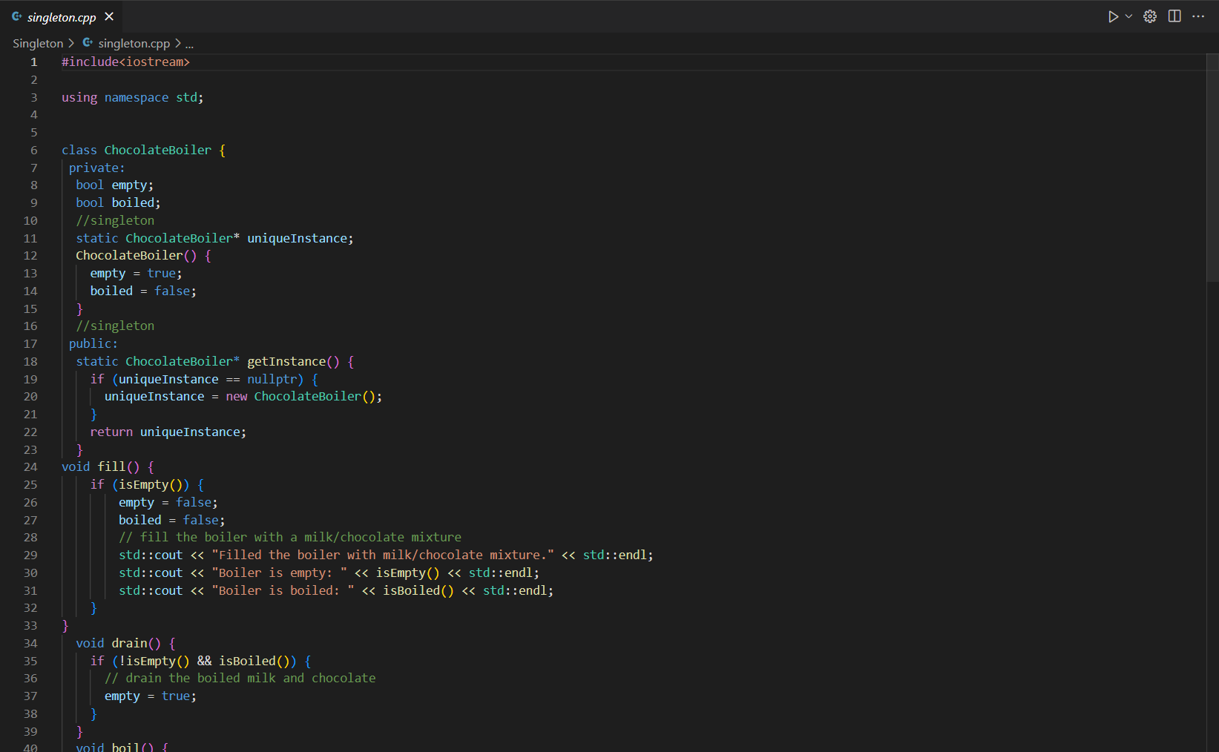
Code showcase

